Slide 1
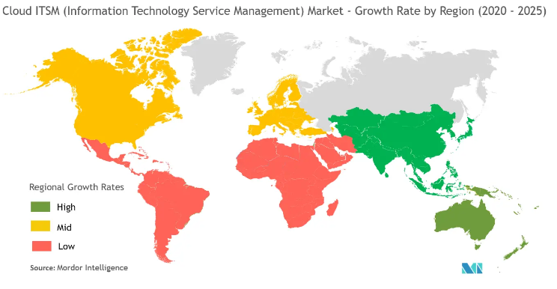
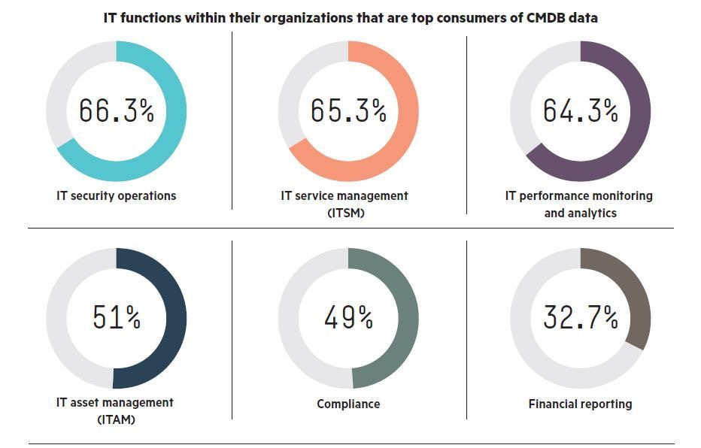
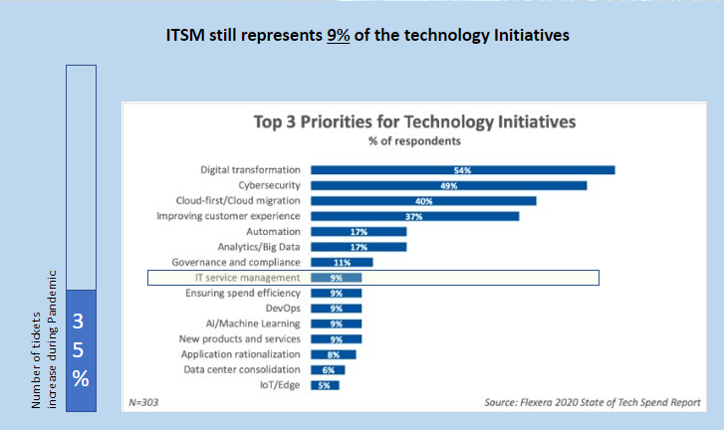
Battlecard - ITSM
Data points - Icebreakers
Business Talk
Pitch
Trump Cards
Cloud ITSM Growth by Region
Expect these Customer Pain Points
Value Proposition
References
Delayed Response
Lack of Product Knowledge by support staff
Redundancy and friction during buying process
High cost of repeat purchase
Solutions not-aligned with organizational needs
High training cost for adoption of software
Inconsistent support level consistency
Rollout Timeframe
Intuitive and immersive user experience
Support multiple platforms including Mobile
Easy to implement and train with promised ROI
Use of AI, Chat BOTS and RPA for automation and ensuring SLA compliance, minimizing errors
Customizable workflow with less manual intervention
Extensive Knowledge bank
MIS and Reports using push notifications
Existing customers
Existing references (Persons you can count on whom your customer can call)
Marketing Handouts
Presentations
Working demo
Trip to a working implementation to showcase your product
Data Quality - CMDB
Ask these Golden Questions
Offerings
Are you happy with your current ITSM Software?
Do you feel that your employees are happy using the product?
What are the 2 major complains in your current ITSM software?
How much of AI or automation are you willing to use?
Organizational Maturity in ITSM (Low-Med-High)
How mature is your CMDB?
How good is your Operational Visibility?
Fully functional and configurable software
Automation using AI, push and learning into Knowledge and Continuous Learning Mgmt.
Complaint with all laws and ITIL framework
Extensive Documentations and training – in person and digitally available
Current data migration to our software
Post implementation support for additional features and warranty for implementation
Pre-defined workflows and
Who to Target
Data Center heads
ITSM practioners
CTO
CEO
and more opportunities for improvement
This is a template to be used by your sales team to sell your ITSM service or product. This should be modified to showcase your own service or product competency and highlight the value proposition and Offerings as your deem fit. The template ensures that there is a consistent message being passed along by your reps to your potential customers. The questions that your customers ask, that are currently not available in the Pain Points sections should make their way into the list – this will refine the customer Pain points and lead to improving your product or service offerings.
We are talking about -

